Slide 1


CHM 103 ORGANIC CHEMSTRY I
Department of Chemical Sciences
Faculty of Science and Technology
Bingham University, Karu
Course Lecturer: Joseph C. Oguegbulu
Joseph.oguegbulu@binghamuni.edu.ng

Slide 2
COURSE CONTENT
Introduction. History, classifications 0.5 week
Carbon: Bonding in organic compounds, structure 0.5 week
Functional groups 0.5 week
IUPAC nomenclature 1 week
Isomerism – Structural & Stereo-isomerism 2 weeks
Hybridisation – Resonance effects & others 2 weeks
Alkanes, Alkenes, Alkynes 1.5 weeks
Alkyl halides, Alkanols 1 week
Carbonyl compounds: Alkanals and Alkanones. 0.5 week

Slide 3
LECTURE I
INTRODUCTION/GENERAL INFORMATION
BACKGROUND
COURSE CONTENT
HISTORICAL PERSPECTIVE
FLASHBACK: SOME BASIC CONCEPTS

Slide 4
COURSE CONTENT
Introduction. History, classifications 0.5 week
Carbon: Bonding in organic compounds, structure 0.5 week
Functional groups 0.5 week
IUPAC nomenclature 1 week
Isomerism – Structural & Stereo-isomerism 2 weeks
Hybridisation – Resonance effects & others 2 weeks
Identification of organic compounds- Purification 0.5 week
Alkanes, Alkenes, Alkynes 1.5 weeks
Alkyl halides, Alkanols 1 week
Carbonyl compounds: Alkanals and Alkanones. 0.5 week

Slide 5
ORG. CHEM.: A HISTORICAL PERSPECTIVE
If CHM 101 is GENERAL CHEMISTRY, why do we do CHM 103???
Why is Organic Chemistry studied?

Slide 6
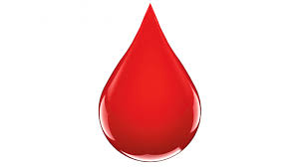
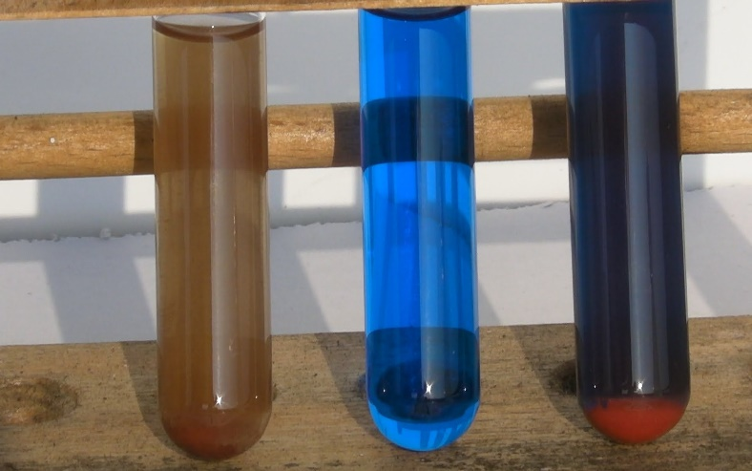
A HISTORICAL PERSPECTIVE: Vitality
Historically, substances that exist in biological systems such as blood, sweat, urine, cholorophyl, rubber, semen, etc were thought to be different from ‘test tube compounds’
They were regarded as possessing a “Vital Force”
This was regarded as the “Theory of VITALITY”
They could not be synthesised from inorganic components
But this was not true!!!

Slide 7

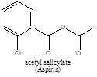
THEORY OF VITALITY DEBUNKED
This idea was held until the 19th century (i.e. 1800s)
UNTIL THE FOLLOWING HAPPENED
Synthesis of carbamide (urea) (Friedrich Wholer1828)
NH4⁺ + ⁻OCN ---------> H₂N-CO-NH₂ (Urea)
Making of soaps from fats&oils (Michel Chevereul 1816)
Synthesis of Perkin’s mauve (Willian Perkins 1856).
Manufacture of aspirin (acetyl salicylate) (1899)

Slide 8
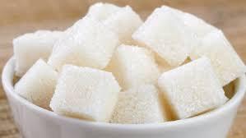
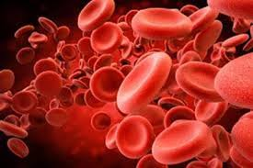
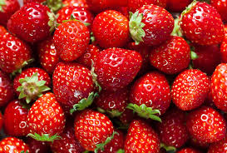
ORGANIC CHEMISTRY: Introduction
Today Organic chemistry is better understood
Org. Chem. is “The chemistry/study of carbon (C) and its compounds”
Also called “Chemistry of Life”
Reason: Lots of compounds found in biological systems are studied
Every organic compound contains carbon
Not all compounds containing carbon are ‘Organic’ e.g. CO₂, HCO₃ etc.

Slide 9
ORGANIC CHEMISTRY: Introduction
Organic Chemistry Studies…
Hydrocarbons
Biomolecules
Organometallics
Petrochemicals
Natural products, etc

Slide 10
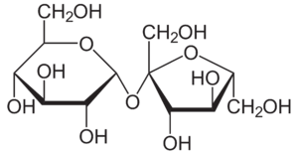
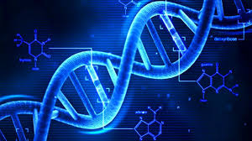
BIOMOLECULES
There are FOUR (4) classes of biomolecules
Carbohydrates (Glucose, sucrose, starch, chitin)
Proteins(Enzymes, receptors, antibodies, skin, hair)
Lipids (Fats, oils, phospholipids, steroids)
Nucleic acids (RNA, DNA)
Sucrose
DNA

Slide 11
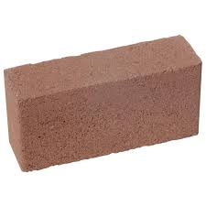
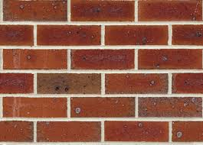
BIOMOLECULES
They are macromolecules (very large molecules) found in nature and biological systems
Sometimes called Biopolymers when made up of monomer units
Proteins <== amino acids
Cabohydrates (sugars) <== monosacharides
Nucleic acids <== single DNA, RNA units
Lipids <== NOT POLYMERS
Monomer
Polymer

Slide 12
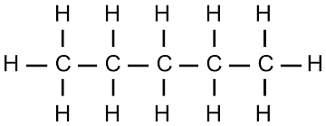
WHY IS CARBON SO SPECIAL
Catenation: Ability to form long carbon to carbon chains. C-C-C-C-C-C. Have you ever seen N-N-N-N-N- or O-O-O-O-O? NO
Strength of the Carbon to Carbon bond
C-C = 350 KJ/mol, N-N =160 KJ/mol, O-O = 150 KJ/mol
Ability to fully utilise its valence electrons
Valence electrons are outermost electrons
E.g. O has 6, but uses 2, N has 5, uses 3, C has 4, uses 4
Different Degrees of Unsaturation; C-C (Saturated);
C=C and C=C (unsaturated)

Slide 13
FLASHBACK
Refresh your memory…
Element, atom, molecule, ion
Neutrons, protons, electrons
Atomic number, mass number
Bonding
Functional groups
etc

